Slide 1
The Scrum-Agile Approach
Tiffany Thai

Slide 2


Various roles on an agile team
Product Owner: The Product Owner represents the stakeholders and is responsible for defining and prioritizing the product backlog. They communicate with stakeholders, gather requirements, and make decisions on what features should be developed. The Product Owner ensures that the team delivers value to the customer and aligns the product vision with business goals.
Scrum Master: The Scrum Master is responsible for facilitating the Scrum process, ensuring that the team adheres to agile principles and the Scrum framework. They remove any obstacles that hinder progress, promote collaboration, and support the team in achieving their goals.
Developer: Developers are responsible for implementing the features and functionalities of the product. They collaborate with the team and follow agile development practices to design, code, and test software solutions. Developers actively participate in sprint planning, daily stand-ups, and other team activities to deliver high-quality increments of the product.
Tester: Testers play a crucial role in ensuring the quality and reliability of the product. They design and execute test cases, verify that the software meets acceptance criteria, and identify and report defects. Testers collaborate closely with developers to address issues and provide feedback, contributing to the overall improvement of the product's quality.
Notes:
References:
Pic credit to SNHU

Slide 3
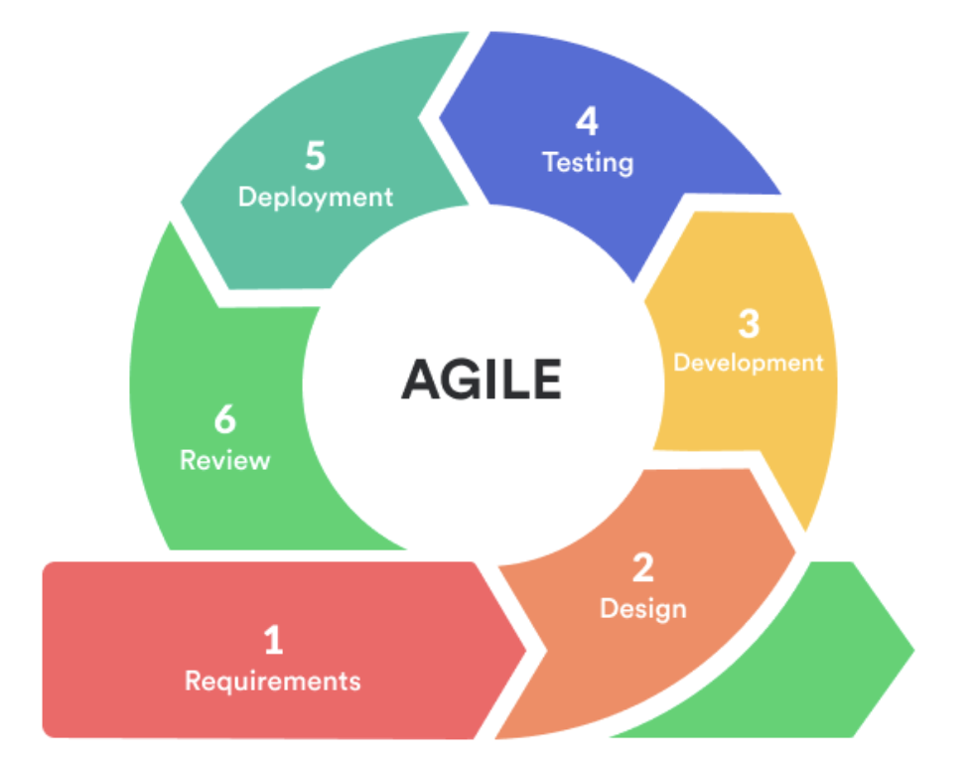
Agile Software Development Life Cycle (SDLC)
Requirements Gathering: In this phase, the product requirements are identified and captured. The emphasis is on understanding the needs of stakeholders and defining user stories or features that align with those needs. Agile practices prioritize collaboration and continuous feedback from stakeholders to ensure accurate and evolving requirements.
Design and Planning: Agile development promotes lightweight and iterative design. The design phase focuses on creating a high-level architecture and identifying the necessary components. The planning phase involves breaking down user stories into smaller tasks and prioritizing work for each iteration or sprint.
Development: The development phase involves implementing the features and functionalities based on the prioritized user stories. Agile teams typically work in short iterations called sprints, typically lasting two weeks, to deliver small increments of the product. Developers collaborate closely, write code, perform unit testing, and integrate their work frequently.
Testing: Testing is integrated throughout the development process in agile. Testers work closely with developers, ensuring that each user story is thoroughly tested to meet acceptance criteria and functional requirements. Test cases are designed, executed, and defects are identified and reported. Agile teams emphasize early and continuous testing to catch issues as early as possible.
Deployment and Delivery: Agile teams aim to deliver working software frequently and incrementally. At the end of each sprint or iteration, the completed user stories are packaged and made ready for deployment.
Review and Iteration: Agile methodologies embrace continuous feedback loops to drive improvements. After each sprint, a review is conducted where stakeholders provide feedback on the delivered features. Retrospectives are also held to reflect on the process, celebrate successes, and identify areas for improvement. This feedback informs the subsequent iterations, allowing the team to adapt and refine their approach.
Notes:
References:
https://mlsdev.com/blog/agile-sdlc

Slide 4
Which is better, Agile or Waterfall?
Agile Model | Traditional Waterfall Model
Iterative and incremental – Development occurs in short cycles or iterations. | Sequential and linear – Each phase is completed before moving onto the next.
Collaboration and flexibility – Collaboration among team and stakeholders throughout the process. Requirements are continually refined. | Fixed requirements – Requirements are known and fixed at the beginning of the project. Changes to requirements are typically challenging to accommodate.
Adaptive planning – Allow for changes in requirements and priorities. | Predictive planning – Relies on upfront planning and documentation.

Slide 5
How to choose?
Project characteristics – Well-defined and stable requirements or evolving requirements and a high degree of uncertainty
Team dynamics – Prefers structured and sequential approach or has strong collaboration, self-organization, and cross-functional skills. Agile can foster creativity, adaptability, and ownership.
Stakeholder involvement – Prefers hand-off approach and review the final product at the end or desire for regular feedback and engagement.

Slide 6
References
Anurina, O. (2021). Agile SDLC: How Your Project Can Benefit From This Model. mlsdev.com. https://mlsdev.com/blog/agile-sdlc
Charles G. Cobb. (2015). The Project Manager’s Guide to Mastering Agile : Principles and Practices for an Adaptive Approach. Wiley.
Radigan, B. D. (n.d.). Agile vs. waterfall project management | Atlassian. Atlassian. https://www.atlassian.com/agile/project-management/project-management-intro

